Slide 1
METHODS
Methods

Slide 2
Today’s Agenda
Topics:
Introduction
Static Methods
Method Declarations
Method Calls
Scope of Declarations
Method Overloading
Random numbers
Reading:
Java how to program Late objects version (D & D)
Chapter 5
The Java Tutorial
https://docs.oracle.com/javase/tutorial/java/javaOO/methods.html

Slide 3
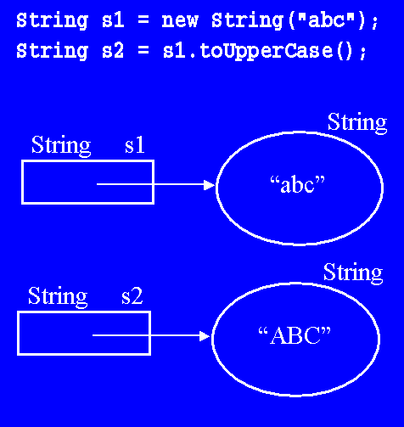
1.Introduction
Best way to develop and maintain a large program is to construct it from small, simple pieces.
It is called divide and conquer
Normally, methods are called on specific objects
Example: toUpperCase() method from a string object.
declare, construct, and initialize a String object
Note: (We will cover the details on creating objects later)
call the toUpperCase() method on the object referred to by the variable s1
construct a new object "ABC"
returns a reference to this new object, and
stored it into s2 in its declaration.
String s1 = new String("abc");
String s2 = s1.toUpperCase();

Slide 4
1.Introduction Instance Methods
String s2 = s1.toUpperCase();
Instance Methods:
Operations we can apply to objects to examine/change their state
We use a variable name to specify which object to call a method on (the object it refers to)
we write the name of the variable, followed by a period (a separator), followed by the name of the method, all followed by a pair of open/close parentheses (separators/delimiters).
Example: the toUpperCase method is called in the form
returns as a result a reference to a new String object whose state is the upper-case version of the state of the object to which object-reference refers.
object-reference.toUpperCase()

Slide 5
1.Introduction String Methods
String str = new String("abcd");
Some popular methods in the String class:
Python | Java | Description
str[3] | str.charAt(3) | Return the char value at the specified index
str[2:5] | str.substring(2,5) | Return a string that is a substring of this string. The substring begins at the specified beginIndex and extends to the character at index endIndex - 1
len(str) | str.length() | Return the length of the string
str.find('x') | str.indexOf('x') | Return the index of the first occurrence of a specified text in a string
str.split() | str.split('\s') | Split the string on whitespace into a list/array of strings
str.split(',') | str.split(',') | Split the string at ',' into a list/array of strings
str + str | str.concat(str) | Concatenate two strings together
str.strip() | str.trim() | Remove any whitespace at the beginning or end

Slide 6
1.Introduction Program Modules in Java
The statements in method bodies are written only once, are hidden from other methods and can be reused from several locations in a program.
Software reusability
using existing methods as building blocks to create new programs
Often, you can create programs from existing classes and methods rather than by building customized code
Dividing a program into meaningful methods makes the program easier to debug and maintain.
Every method should be limited to performing a single, well-defined task, and the name of the method should express that task effectively

Slide 7
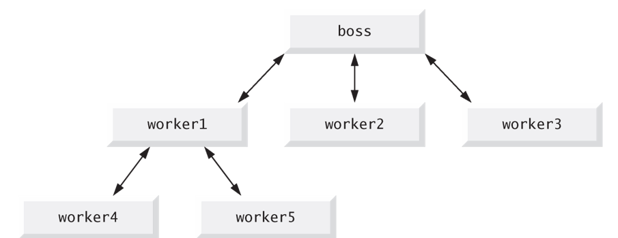
1.Introduction Program Modules in Java
A method is invoked by a method call
When the called method completes its task, it returns control—and possibly a result — to the caller
Similar to the hierarchical form of management
A boss (the caller) asks a worker (the called method) to perform a task and report back (return) the results after completing the task
The boss method does not know how the worker method performs its designated tasks
The worker may also call other worker methods, unbeknown to the boss
This “hiding” of implementation details promotes good software engineering

Slide 8
1.Introduction Calling Methods
Three ways to call a method:
Using a method name by itself to call another method of the same class
Using an object’s variable name followed by a dot (.) and the method name to call a non-static method of the object
Using the class name and a dot (.) to call a static method of a class
returnVar = methodName(parameters);
returnVar = an_object.methodName(parameters);
String s2 = s1.toUpperCase();
returnVar = className.methodName(parameters);
int value = Math.min(10, 2);

Slide 9
2.Static Methods
Sometimes a method performs a task that does not depend on the contents of any object
Method applies to the class in which it’s declared as a whole and is known as a static method or a class method
For any class imported into your program, you can call the class’s static methods by specifying the name of the class in which the method is declared, followed by a dot (.) and the method name
All Math class methods are static
Method arguments may be constants, variables or expressions
Example:
System.out.println(Math.min(20, 1));

Slide 10
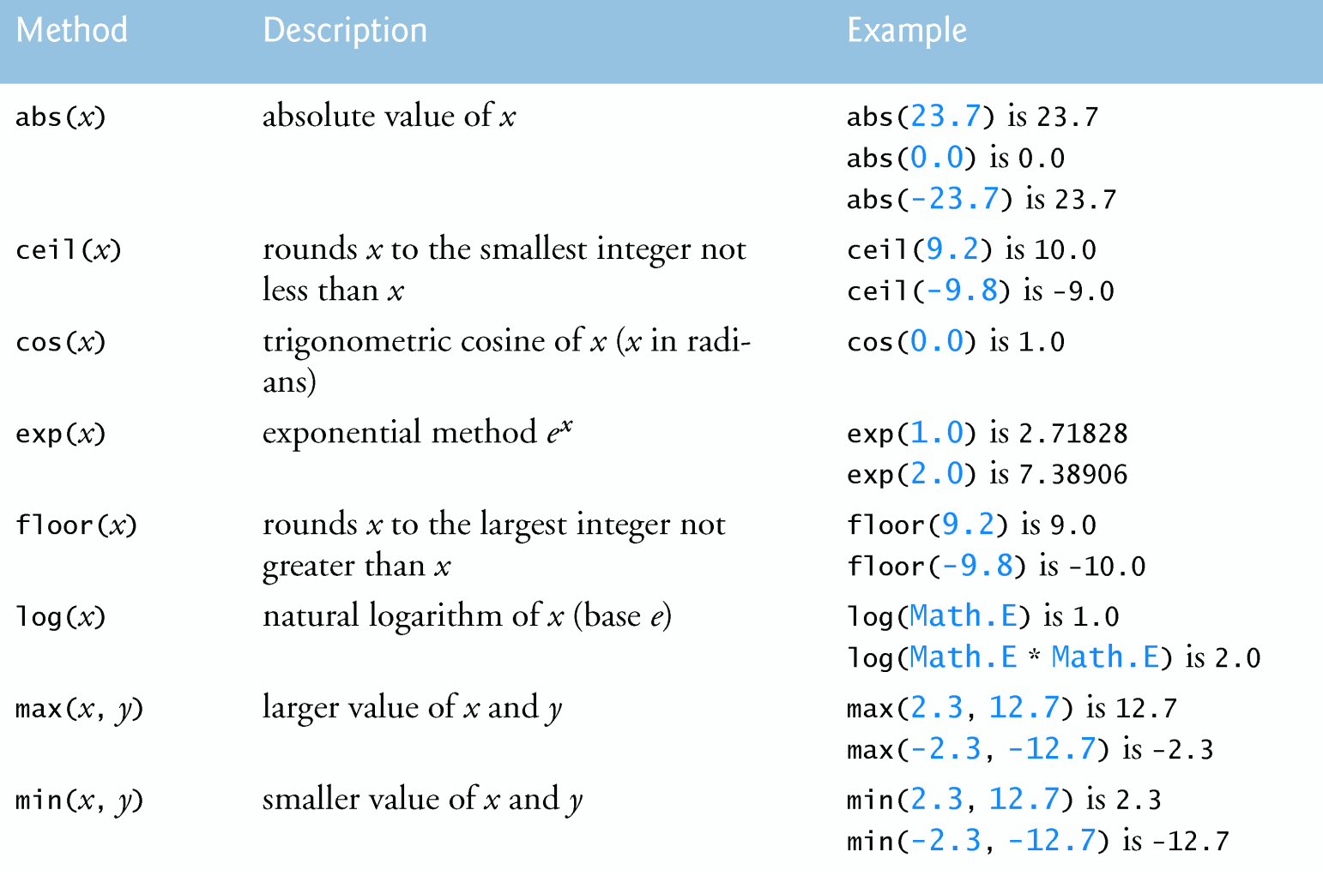
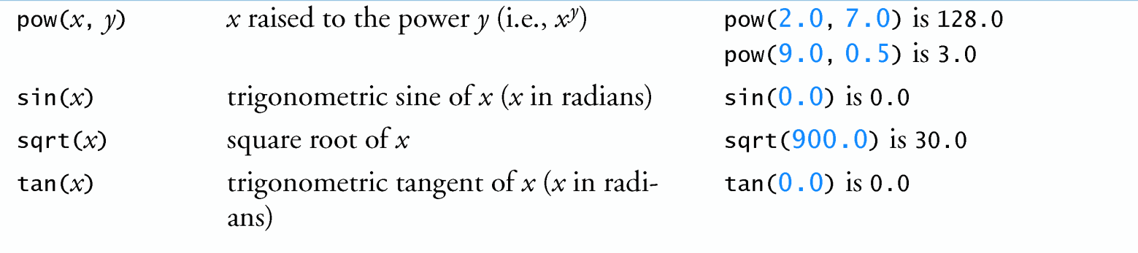
2.Static Methods The Math class

Slide 11
2.Static Methods The Math class
Class Math declares two constants
Math.PI (3.141592653589793) is the ratio of a circle’s circumference to its diameter
Math.E (2.718281828459045) is the base value for natural logarithms (calculated with static Math method log)
These constants are declared in class Math with the modifiers public, static and final.
public allows you to use these fields in any other classes
static allows them to be accessed via the class name Math and a dot (.) separator
final indicates that they are constants—value cannot change after they are initialized.
A class’s variables are sometimes called fields.

Slide 12
2.Static Methods The Main method
Why Is the method main declared static?
When you execute the Java Virtual Machine (JVM) with the java command, the JVM attempts to invoke the main method of the class you specify.
i.e. This is the line at which the program will start executing.
All Java applications begin execution by calling main.
Declaring main as static allows the JVM to invoke main without creating an object of the class.
If we omit static keyword before main, Java program will successfully compile but it won't execute.

Slide 13
3.Method Declarations (static methods) Method Header
Method header: Modifiers, return type, method name and parameters
A public method is “available to the public”
It can be called from methods of other classes
static methods: can be called without creating an object of class.
Method name : Style convention :
Class names, method names and variable names are all use the same camel case naming scheme (e.g. toUpperCase)
return type : Specifies the type of data a method returns
void : perform a task but will not return any information
Parameters: (additional information to perform its task)
Defined in a comma-separated parameter-list
Each parameter must specify a type and an identifier
They are local variables of that method and can be used only in that method’s body
For now, we begin every method declaration with the keywords public and static
public static void methodName1(int parameter) { ... }
public static int methodName2(int parameter) { ... }

Slide 14
3.Method Declarations (static methods) Method body
Method body
Delimited by left and right braces
Contains one or more statements that perform the method’s task
A return statement returns a value (or just control) to the point in the program from which the method was called
There are three ways to return control to the statement that calls a method
If the method does not return a result, control returns when the program flow reaches the method-ending right brace or when the statement return; executes
If the method returns a result, the statement
evaluates the expression, then returns the result to the caller
return expression;
public static void methodName1(int parameter) {
...
}

Slide 15
3.Method Declarations (static methods) Example
L05Code.java
Example: determines and returns the largest of two double values
public static void main(String[] args) {
Scanner input = new Scanner(System.in);
System.out.print("Enter 2 numbers separated by spaces: ");
double num1 = input.nextDouble();
double num2 = input.nextDouble();
double result = max_of_2(num1, num2);
System.out.println("Maximum is: " + result);
}
public static double max_of_2(double x, double y) {
return Math.max(x, y);
}
Enter 2 numbers separated by spaces: 9.35 2.74
Maximum is: 9.35

Slide 16

Exercise 1
98 Fahrenheit is 36 Celsius
26 Celsius is 78 Fahrenheit
Consider the following code fragment in Main:
Complete two static methods to convert Celsius temperature to Fahrenheit and Fahrenheit to Celsius
int f = 98, c = 26;
System.out.printf("%d Fahrenheit is %d Celsius%n%n", f, celsius(f));
System.out.printf("%d Celsius is %d Fahrenheit%n%n",c, fahrenheit(c));
Return an int!
!
public static int celsius(int fahrenheitTemperature) {
...
public static int fahrenheit(int celsiusTemperature) {
...

Slide 17
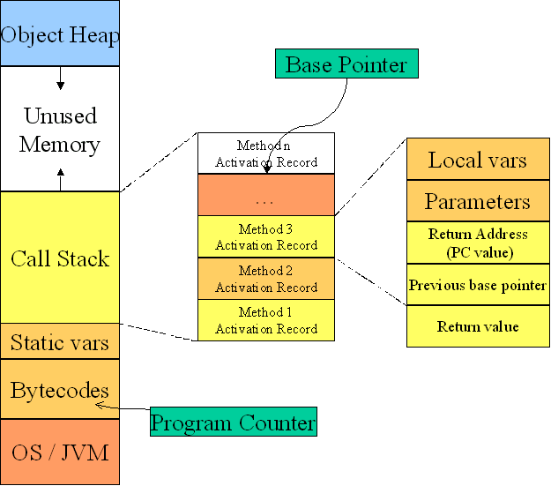
4.Method Calls Activation Records
When a program calls a method, the called method must know how to return to its caller, so the return address of the calling method is pushed onto the method-call stack
It also contains the memory for the local variables (including the method parameters) used in each invocation of a method
This data, stored as a portion of the method-call stack, is known as the stack frame (or activation record) of the method call

Slide 18
4.Method Calls Method-Call Stack
If a series of method calls occurs, the successive return addresses are pushed onto the stack in last-in, first-out order

Slide 19
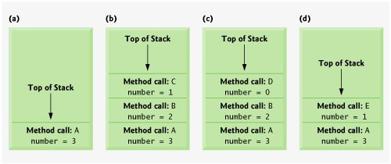
4.Method Calls Method-Call Stack
When a method returns to its caller, the stack frame for the method call is popped off the stack and those local variables are no longer known to the program.

Slide 20
5.Scope of Declarations
Declarations introduce names that can be used to refer to classes, methods, variables and parameters
The scope of a declaration is the portion of the program that can refer to the declared entity by its name
Any block may contain variable declarations.
Basic scope rules:
The scope of a local-variable declaration that appears in the initialization section of a for statement’s header is the body of the for statement and the other expressions in the header.
The scope of a local-variable declaration is from the point at which the declaration appears to the end of that block.
for (int n=1; n<5; n++)
System.out.prinltn(n);

Slide 21

5.Scope of Declarations Rules
The scope of a parameter declaration is the body of the method in which the declaration appears.
A method or field’s scope is the entire body of the class.
parameter
public static void method(int n) {
int n =0;
int x = 5;
}
Local variable
variable n is already defined in method method(int)
int n =0;

Slide 22
5.Scope of Declarations Rules
L05Code02.java
If a local variable or parameter in a method has the same name as a field of the class, the field is hidden until the block terminates execution. It is called shadowing
Fields: accessible to all methods from the class itself.
The static field (whose value is 1) is shadowed in main.
field
public class L05Code02 {
public static int x = 1; //a field
public static void main(String[] args) {
int x = 5; //method's local variable x shadows field x
System.out.printf("local x=%d%n", x);
method();
}
public static void method() {
System.out.printf("field x=%d%n", x);
}
}
Local variable
local x=5
field x=1
field

Slide 23
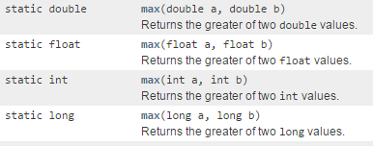
6.Method Overloading
Methods of the same name can be declared in the same class, as long as they have different sets of parameters
It is called method overloading
The compiler selects the appropriate method to call by examining the number, types and order of the arguments in the call
Used to create several methods that perform the same or similar tasks on different types or different numbers of arguments
Math methods abs, min and max are overloaded with four versions each:
two double parameters, two float parameters, two int parameters, two long parameters
System.out.println(Math.max(10, 12));
System.out.println(Math.max(10.5, 12.5));
12
12.5

Slide 24
6.Method Overloading Rules
L05Code02.java
Compiler distinguishes overloaded methods by their signatures
A combination of the method’s name and the number, types and order of its parameters, but not its return type.
The return type of the method is NOT part of the signature
The compiler must be able to determine which version of the method is being invoked by analysing the parameters
public static void aMethod() {
System.out.println("called aMethod()");
}
Zero-parameter
public static void aMethod(int x, String y, boolean z) {
System.out.println("called aMethod(int x, String y, boolean z)");
}
3-parameters (int, String, boolean)
public static void aMethod(String y, int x, boolean z) {
System.out.println("called aMethod()");
}
3-parameters (String, int, boolean)

Slide 25
6.Method Overloading Rules
Method calls cannot be distinguished by return type
Note: Overloaded methods can have different return types if the methods have different parameter lists
Methods have different return types but with the same signature
:- result in compiler error
public static void aMethod(int x, String y, boolean z) {
System.out.println("called aMethod(int x, String y, boolean z)");
}
public static int aMethod(int x, String y, boolean z) {
...
3-parameters (int, String, boolean)
error: aMethod(int,String,boolean) is already defined in…

Slide 26
6.Method Overloading Argument Promotion
L05Code02.java
Argument promotion—converting an argument’s value, if possible, to the type that the method expects to receive in its corresponding parameter
promotion rules: int -> double, float -> double etc
Note:
Literal integer values are treated as type int
Literal floating-point values are treated as type double
sum(20, 20);
public static void sum(int a, double b){
System.out.println(a+b);
System.out.println("Two args");
}
public static void sum(int a,int b,int c){
System.out.println(a+b+c);
System.out.println("Three args");
}
40.0
Two args

Slide 27
Exercise 2 - Overloading
Valid or invalid?
Case 1:
Case 2:
Case 3:
Case 4:
int mymethod(int a, int b, float c)
int mymethod(int var1, int var2, float var3)
int mymethod(int a, int b)
int mymethod(float var1, float var2)
int mymethod(int a, int b)
int mymethod(int num)
float mymethod(int a, float b)
float mymethod(float var1, int var2)

Slide 28
7.Random Numbers
The element of chance can be introduced in a program via an object of class SecureRandom
From package java.security
Such objects can produce random boolean, byte, float, double, int, long and Gaussian values.
SecureRandom objects produce nondeterministic random numbers that cannot be predicted.
The nextInt() that receives an int argument and returns a value from 0 up to, but not including, the argument’s value.
Note: To generate a series of random numbers as a unit, you need to use a single Random object - do not create a new Random object for each new random number.
SecureRandom randomNumbers = new SecureRandom();
for (int counter=0; counter<=20; counter++)
System.out.printf("%d ", randomNumbers.nextInt(6));
0 <= random number <=5
2 4 3 5 1 2 0 0 3 0 3 5 0 2 5 1 2 1 2 0 3

Slide 29
7.Random Numbers Scaling and Shifting
L05Code03.java
Generalized scaling and shifting of random numbers:
where shiftingValue specifies the first number in the desired range of consecutive integers and scalingFactor specifies how many numbers are in the range
Example: Simulating dice
Valid values: 1, 2, 3, 4, 5, 6
SecureRandom randomNumbers = new SecureRandom();
number = shiftingValue + randomNumbers.nextInt(scalingFactor);
randomNumbers.nextInt(6)
0
1
2
3
4
5
1 + randomNumbers.nextInt(6)
1
2
3
4
5
6

Slide 30

Exercise 3
Complete the code to allow a user to guess a number (from 0 to 10) that will be randomly generated by computer.
Scanner input = new Scanner(System.in);
int guessNum, randNum;
SecureRandom randomNumbers = new SecureRandom();
__________________
System.out.print("Enter your guess number (0-10):");
_____________________
if (guessNum == randNum)
System.out.printf("You won.");
else {
System.out.printf("You lost. My number is %d%n.", randNum);
}
Enter your guess number (0-10):5
You lost. My number is 9
Enter your guess number (0-10):5
You lost. My number is

